Slide 1
Priority Vs Severity
| By David Kent | Priority vs Severity Presentation |
Notes:
Presentation on Priority vs Severity
Outline. We will cover today, what is priority and some of it’s types, what is severity and its classification.
How it’s used within an software environment.
Why it’s used

Slide 2
Priority
Priority defines the order in which we should resolve a defect.
| By David Kent | Priority vs Severity Presentation |
Notes:
Priority defines the order in which we should resolve a defect. Should we fix it now, or can it wait? This priority status is set by the tester to the developer mentioning the time frame to fix the defect. If high priority is mentioned then the developer has to fix it at the earliest. The priority status is set based on the customer requirements. For
example: If the company name is misspelled in the home page of the website, then the priority is high and severity is low to fix it.

Slide 3
Priority Types
Low
Medium
High
| By David Kent | Priority vs Severity Presentation |
Notes:
Low: The defect is an irritant which should be repaired, but repair can be deferred until after more serious defect have been fixed.
Medium: The defect should be resolved in the normal course of development activities. It can wait until a new build or version is created.
High: The defect must be resolved as soon as possible because the defect is affecting the application or the product severely. The system cannot be used until the repair has been done.

Slide 4
Severity
It is the extent to which the defect can affect the software
| By David Kent | Priority vs Severity Presentation |
Notes:
It is the extent to which the defect can affect the software. In other words it defines the impact that a given defect has on the system. For example: If an application or web page crashes when a remote link is clicked , but it is rare for a user to do that, but the impact of application crashing is severe. The severity will be high but priority is low.

Slide 5
Severity Types
Critical
Major
Moderate
Minor
Cosmetic
| By David Kent | Priority vs Severity Presentation |
Notes:
Critical: The defect that results in the termination of the complete system or one or more component of the system and causes extensive corruption of the data. The failed function is unusable and there is no acceptable alternative method to achieve the required results then the severity will be stated as critical.
Major: The defect that results in the termination of the complete system or one or more component of the system and causes extensive corruption of the data. The failed function is unusable but there exists an acceptable alternative method to achieve the required results then the severity will be stated as major.
Moderate: The defect that does not result in the termination, but causes the system to produce incorrect, incomplete or inconsistent results then the severity will be stated as moderate.
Minor: The defect that does not result in the termination and does not damage the usability of the system and the desired results can be easily obtained by working around the defects then the severity is stated as minor.
Cosmetic: The defect that is related to the enhancement of the system where the changes are related to the look and field of the application then the severity is stated as cosmetic.

Slide 6
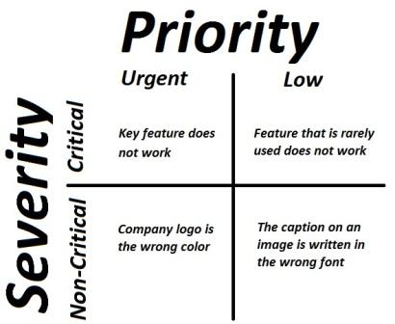
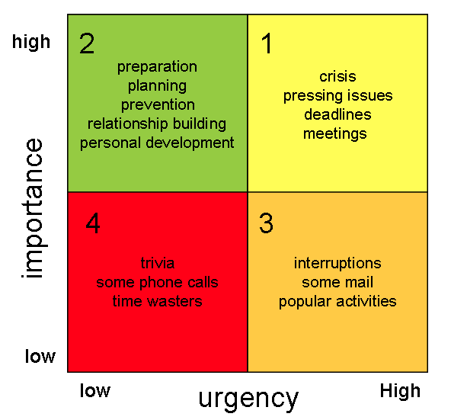
Models & Examples
| By David Kent | Priority vs Severity Presentation |
Notes:
Priority Vs Severity Model
High Priority & High Severity: An error which occurs on the basic functionality of the application and will not allow the user to use the system. (Eg. A web store site loses the ability to take payments for goods, without payment the site cannot operate as indented. Then this is high priority and high severity bug.)
High Priority & Low Severity: The spelling mistakes that happens on the cover page or heading or title of an application.
High Severity & Low Priority: An error which occurs on the functionality of the application (for which there is no workaround) and will not allow the user to use the system but on click of link which is rarely used by the end user.
Low Priority and Low Severity: Any cosmetic or spelling issues which is within a paragraph or in the report (Not on cover page, heading, title).
Eisenhower Model –
Based on a similar approach, where importance and severity can be mixed/ priority and ugency.
It’s a method for testers to let developers know what they should be working on

Slide 7
Questions?
| By David Kent | Priority vs Severity Presentation |

Slide 8
Summary
Priority: Order in which defects should be addressed and fixed
Severity: How bad the defect affect the systems.
Why?: As a method to help
| By David Kent | Priority vs Severity Presentation |
Notes:
Covered what is Priority, being an order in which a defect should be handled
Severity, being a designation on how bad the defect affect the system
Why it’s used, to help testers let developer know which bugs to go for. Makes it easier to see at a glance which needs doing.

